Slide 1
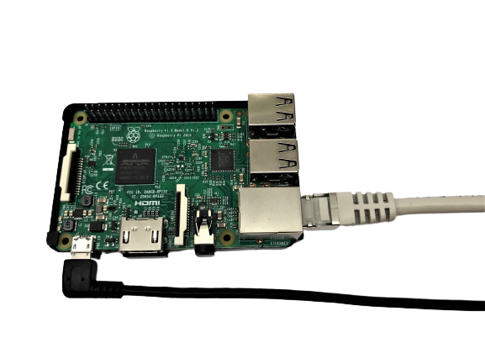




Headless Raspberry Pi
No display!
2022 version!

Slide 2

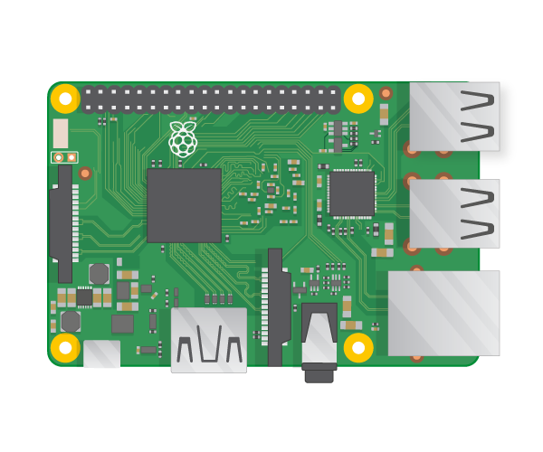


Headless Raspberry Pi
Equipment:
Raspberry Pi
SD Card
SD card reader
Network cable
USB Power cable (micro usb or USB-C)
Computer with ethernet port or ethernet dongle
SSH
Notepad++
Raspberry Pi Imager
Notes:
Advantages with this method: Less equipment
Method works with regular wireless LAN too.
Why two connections?

Slide 3
Notes:
Advantages with this method: Less equipment
Method works with regular wireless LAN too.
Why two connections?

